Slide 1
Odyssey of the Mind
2017-2018

Slide 2
Good Morning!
Please look to the boards on your left and right of the screen.
These are what Odyssey of the Mind Teams call "Spontaneous Problems". The two you see here are considered of the "Verbal" variety.
Either on the board or on the paper provided, list as many things as you can think of that fit the prompt. Enjoy!
(There are examples of other spontaneous problems on each table.)

Slide 3
What is
Odyssey of the Mind?
Student Centered
Creative Problem Solving
Long Term Problems
Spontaneous Problems
Adults facilitate, but cannot give advice—only well placed questions!
Team Building

Slide 4
Team Information
Each team will have up to 7 student members.
Both the student and the parent must agree to make a commitment to the team.
The number of teams will depend on the number of volunteer coaches.
Although Pleasant Union's PTA sponsors the group as a whole, Odyssey is not a school activity, so the team can meet wherever and whenever it decides

Slide 5
Commitment
Time
About once/week for 1 hour (Sept-Nov)
Once or twice/week for 1 hour (Dec-Jan)
As needed to prepare for March
Financial
PTA will donate $135 for Group Membership
Individual Teams will have to supply costs
- Problem costs ($125-$145/team)
- Regional Costs (About $105/team)
Effort
Become a coach, asst. coach or support parent
Every parent will have a role.

Slide 6
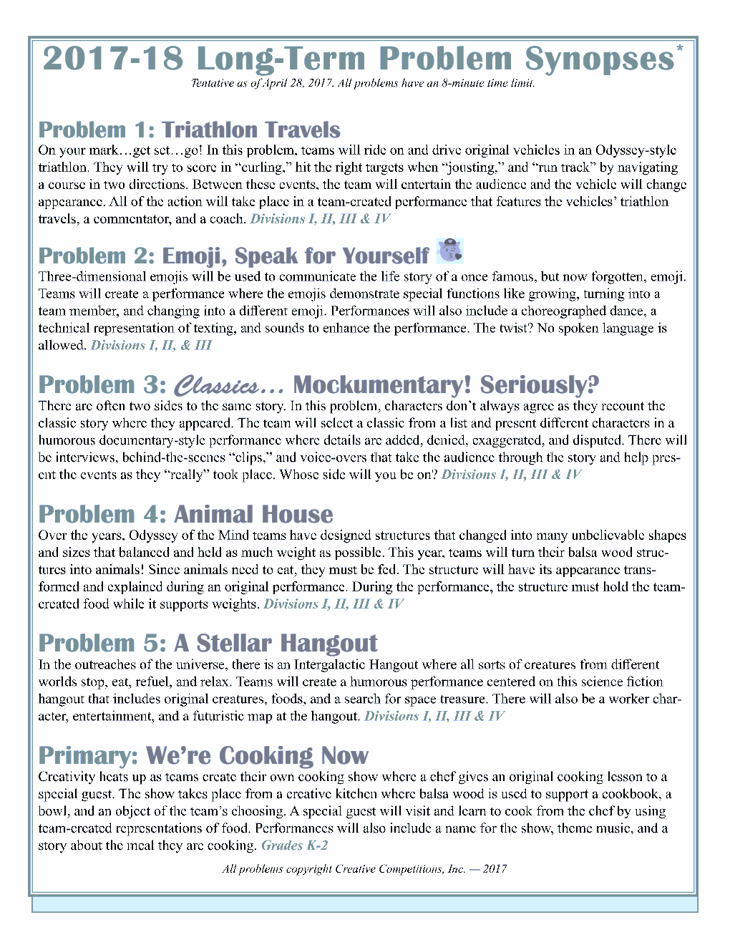

Slide 7
Ways to Volunteer
Coach/Facilitator - at least 2 for each team
Paperwork/Website
Rule Follower
Judge /Volunteer at the competition (one of each per team)
Assemble Spontaneous Problem Kits
Order/Assemble Materials
Fundraiser organizer
Host Site (offer your home)
Contribute snack
Take kids to the Spontaneous Fair
View webinar and share out information

Slide 10
Eastern Region Coaches Training
Date: Saturday, October 28, 2017
Region: Eastern Region
Contact Name: Tom Hansen
Contact Email: Tom.Hansen.OotM@gmail.com
Website: http://www.ncome.org
Location: Wake Tech CC
Eastern Region Skills Fair
Date: Saturday, November 11, 2017
Region: Eastern Region
Contact Name: Randy Burton
Contact Email: Tom.Hansen.OotM@gmail.com
Website: http://www.ncome.org
Location: TBA
Eastern Region Spontaneous Fair
Date: Saturday, January 27, 2018
Region: Eastern Region
Contact Name: Christine Bonin
Contact Email: Tom.Hansen.OotM@gmail.com
Website: http://www.ncome.org
Location: TBA
Eastern Region Judges Training
Date: Saturday, February 17, 2018
Region: Eastern Region
Contact Name: Tom Hansen
Contact Email: Tom.Hansen.OotM@gmail.com
Website: http://www.ncome.org
Location: TBA
Eastern Region Tournament
Date: Saturday, March 3, 2018
Region: Eastern Region
Contact Name: Tom Hansen
Contact Email: Tom.Hansen.OotM
Website: http://www.ncome.org
Location: Wake Tech Community College
State Tournament
DATE: Saturday, March 24, 2018
Location: Wingate University
World Finals
DATE: Saturday, May 24-27, 2018
Location: Iowa State University

Slide 11
Ready to Commit?
If you would like to co-coach a team please turn in your personal information flyer by Friday, September 15 (or before).
If your child would like to participate, please have him/her complete a commitment/ranking form and return to Ms. Shipley by Friday, September 15 (or before).
Our first Coaches' meeting is scheduled for Friday, September 25 at 9:00AM in the AIG Room.

