Slide 1
Odyssey of the Mind
2019-2020

Slide 2
Good Morning!
Welcome☺
Take some time to get to know each other and/or look over the examples of spontaneous problems located on each table.

Slide 3
What is Odyssey of the Mind?
Student Centered
Creative Problem Solving
Long Term Problems
Spontaneous Problems
Adults facilitate, but cannot give advice—only well placed questions!
Team Building
OM VIDEO

Slide 4
Team Information
Each team will have up to 7 student members.
Both the student and the parent must agree to make a commitment to the team.
The number of teams will depend on the number of volunteer coaches.
Although Pleasant Union's PTA sponsors the group as a whole, Odyssey is not a school activity, so the team can meet wherever and whenever it decides

Slide 5
Commitment
Time
About once/week for 1 hour (Sept-Nov)
Once or twice/week for 1 hour (Dec-Jan)
As needed to prepare for March
Financial
PTA will donate $135 for Group Membership
Individual Teams will have to supply costs
- Problem costs ($125-$145/team)
- Regional Costs (About $105/team)
Effort
Become a coach, asst. coach or support parent
Every parent will have a role.

Slide 7
Ways to Volunteer
Coach/Facilitator - at least 2 for each team
Paperwork/Website
Rule Follower
Judge /Volunteer at the competition (one of each per team)
Assemble Spontaneous Problem Kits
Order/Assemble Materials
Fundraiser organizer
Host Site (offer your home)
Contribute snack
Take kids to the Spontaneous Fair
View webinar and share out information

Slide 8
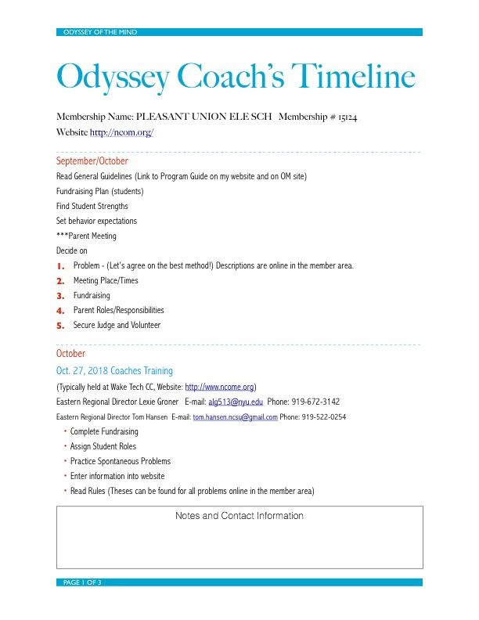

Slide 9
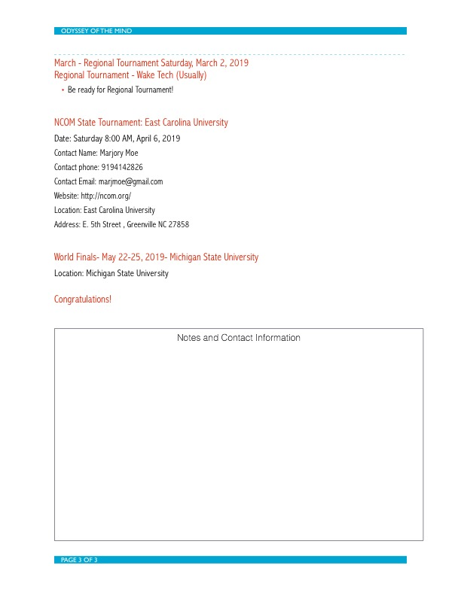

Slide 10
Eastern Region Coaches Training
Date: Saturday, October , 2019
Region: Eastern Region
Contact Name: Tom Hansen
Contact Email: Tom.Hansen.OotM@gmail.com
Website: http://www.ncome.org
Location: Wake Tech CC
Eastern Region Skills Fair
Date: Saturday, November , 2019
Region: Eastern Region
Contact Name: Randy Burton
Contact Email: Tom.Hansen.OotM@gmail.com
Website: http://www.ncome.org
Location: TBA
Eastern Region Spontaneous Fair
Date: Saturday, January , 2020
Region: Eastern Region
Contact Name: Christine Bonin
Contact Email: Tom.Hansen.OotM@gmail.com
Website: http://www.ncome.org
Location: TBA
Eastern Region Judges Training
Date: Saturday, February , 2020
Region: Eastern Region
Contact Name: Tom Hansen
Contact Email: Tom.Hansen.OotM@gmail.com
Website: http://www.ncome.org
Location: TBA
Eastern Region Tournament
Date: Saturday, March 7, 2020
Region: Eastern Region
Contact Name: Tom Hansen
Contact Email: Tom.Hansen.OotM
Website: http://www.ncome.org
Location: Wake Tech Community College
State Tournament
DATE: Saturday, April , 2020
Location: East Carolina University
World Finals
DATE: Saturday, May , 2020
Location: Michigan State University

Slide 11
Ready to Commit?
Work with your co-coach to build your team.
Connect with parents and ask for support in specific ways
Establish meeting times and plan first meeting
Establish norms and values amongst team members
Plan fundraiser
Begin working on Spontaneous Problems

